Slide 1
A Dashboard for Mitigating the COVID-19 Misinfodemic
Zhengyuan Zhu, Kevin Meng, Josue Caraballo, Israa Jaradat, Xiao Shi, Zeyu Zhang, Farahnaz Akrami, Haojin Liao, Fatma Arslan, Damian Jimenez, Mohammed Samiul Saeef, Paras Pathak, Chengkai Li
Presenter: Zhengyuan Zhu

Slide 2
Outline
Project Goal
Project Demo
Model Architecture
Experiments
Findings
Conclusion

Slide 3
Project Goal
Build a dashboard displays the most prevalent facts and debunks of misinformation among Twitter users in any user selected U.S. geographic region.
Facts and debunks: Curate facts and debunks come from a catalog of COVID-19.
Misinformation: Social media tweets hold a disagree stance towards a fact/debunk.
Example:
Tweet: Coronavirus cannot be passed by dogs or cats but they can test positive.
Fact: There has been no evidence that pets such as dogs or cats can spread the coronavirus.
Stance: agree

Slide 4
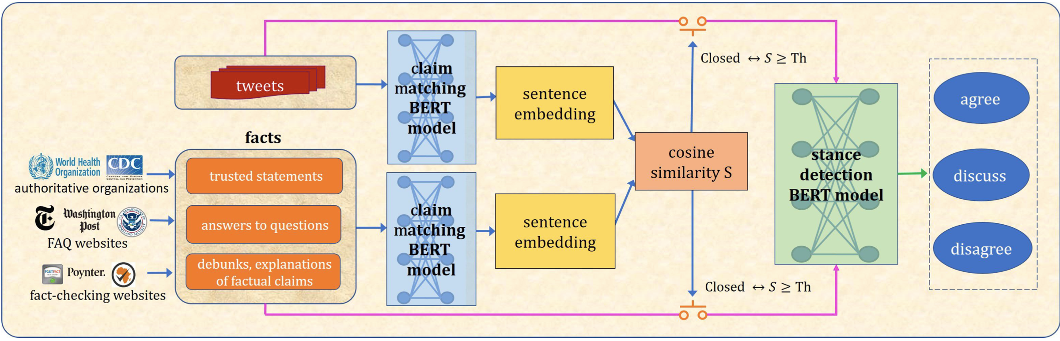
Model structure
Dataset:
Tweet: using a collection of approximately 250 million COVID-19 related tweets.
Facts: manually curated a catalog, which currently has 9,512 entries from 21 credible websites
Methods: two-stage pipeline for detecting misinformation
Claim Matching: Sentence BERT
Stance Detection: Stance BERT

Slide 5
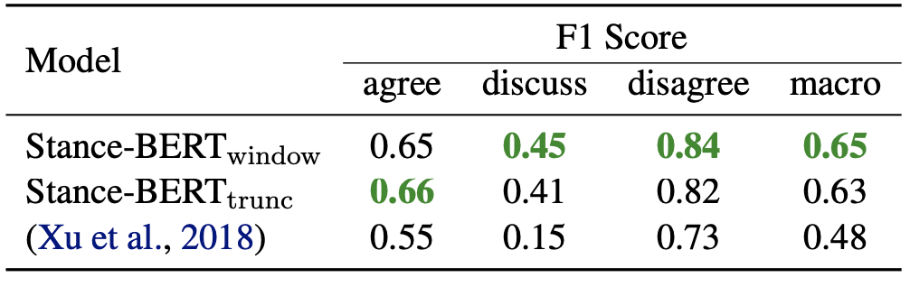
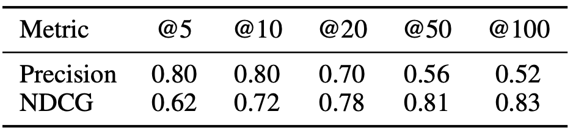
Experiments
Stance BERT performance on FNC-1 Dataset:
Stance BERT performance on COVID-19 Dataset:
Notes:
1.

Slide 6
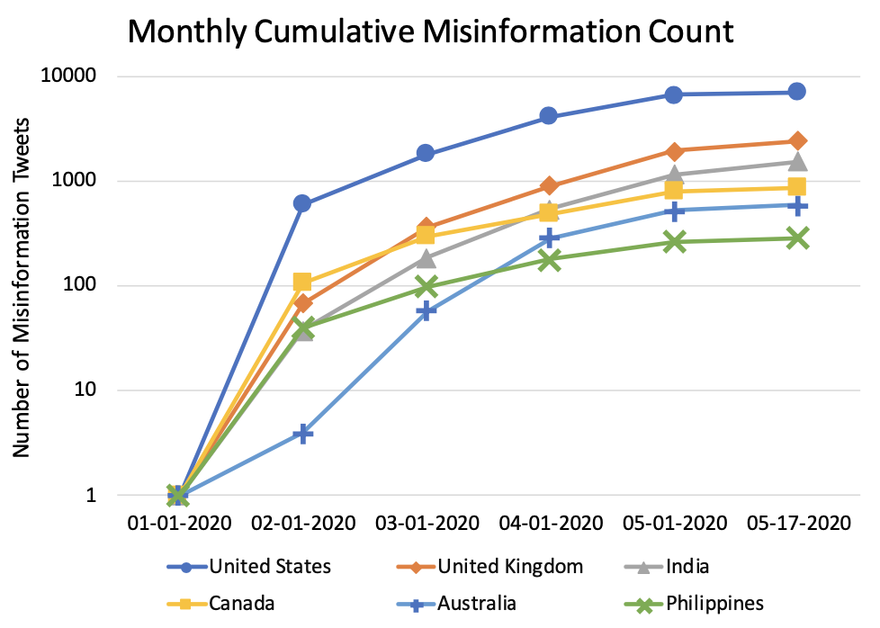
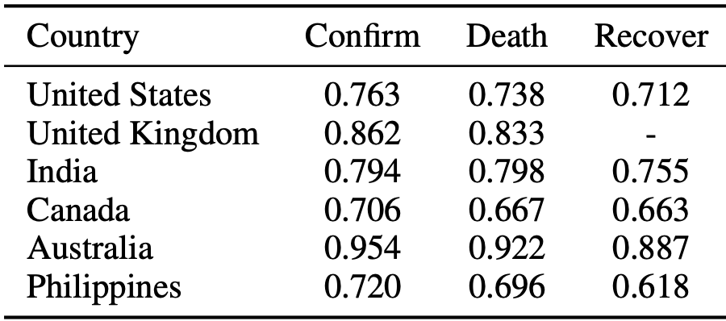
Findings
Top 6 countries with the most misinformation tweets:
Correlation between the percentage of confirmed/deceased/recovered cases and the percentage 578 of misinformation tweets.
Notes:
1.

Slide 7
Conclusion
In this demonstration, we introduce an information dashboard constructed in the context of our ongoing project regarding the COVID-19 misinfodemic.
Going forward, we will focus on developing the dashboard at scale, including more comprehensive tweet collection and catalog discovery and collection.
We will collect more labeled data for improving and evaluating our Stance-BERT models.
We will also introduce more functions into the dashboard that are aligned with our project goal of studying the surveillance of, impact of, and intervention on COVID-19 misinfodemic.
Notes:
1.

